Slide 1
LLM Workshop Part 2: Further Prompt Engineering
By Fardin Ahsan

Slide 2
Overview
This session is going to be mostly hands on.
There will be a small 15 minutes review.
The remainder will be you guys programming up your own chatbot from scratch.

Slide 3
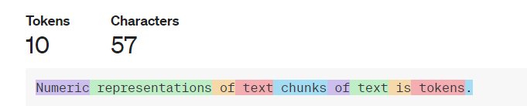
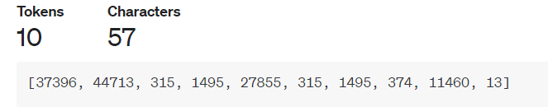
Refresher. Language models are next token predictors.

Slide 4
Refresher. LLM types
These are not written in stone ! But since OpenAI is leading the charge in LLM development. Most other LLM’s follow a similar metamodel architecture.
Foundation text completion models: Raw next token predictors.
Chat models are that foundational models that have been have finetuned to appear to be “conversational”. They are the same thing as text completion models.
Embedding models. Models that product vector representations of text.
Multi modal models: Models that can deal with I/O data types other than text. For example OpenAI’s gpt-4 can take images as inputs.

Slide 5
Refresher. Gotchas.
User interfaces are NOT LLM’s. For example, ChatGPT is not the LLM. ChatGPT is a packaged application that is the combination of an LLM, a graphical user interface, memory, and whole host of other things.
Terminology changes between models. What is a token for OpenAI is not a token for Meta. Even though there are some commonly used terms.
Prompt engineering is experimental. That which works for one model doesn’t necessarily mean it will work for another. That which works on one dataset won’t work on another. ( “No Free Lunch Theorem”)

Slide 6
The OpenAI playground
The OpenAI playground is a web interface for interacting with OpenAI’s LLM’s.
It has more features than the ChatGPT web application that is widely used.
Deleting specific messages.
Raw prompts. (ChatGPT prepends instructions to your prompt).
Adjusting output parameters.
System prompt.
Use the Playground to iterate on your work more effectively and faster.

Slide 7
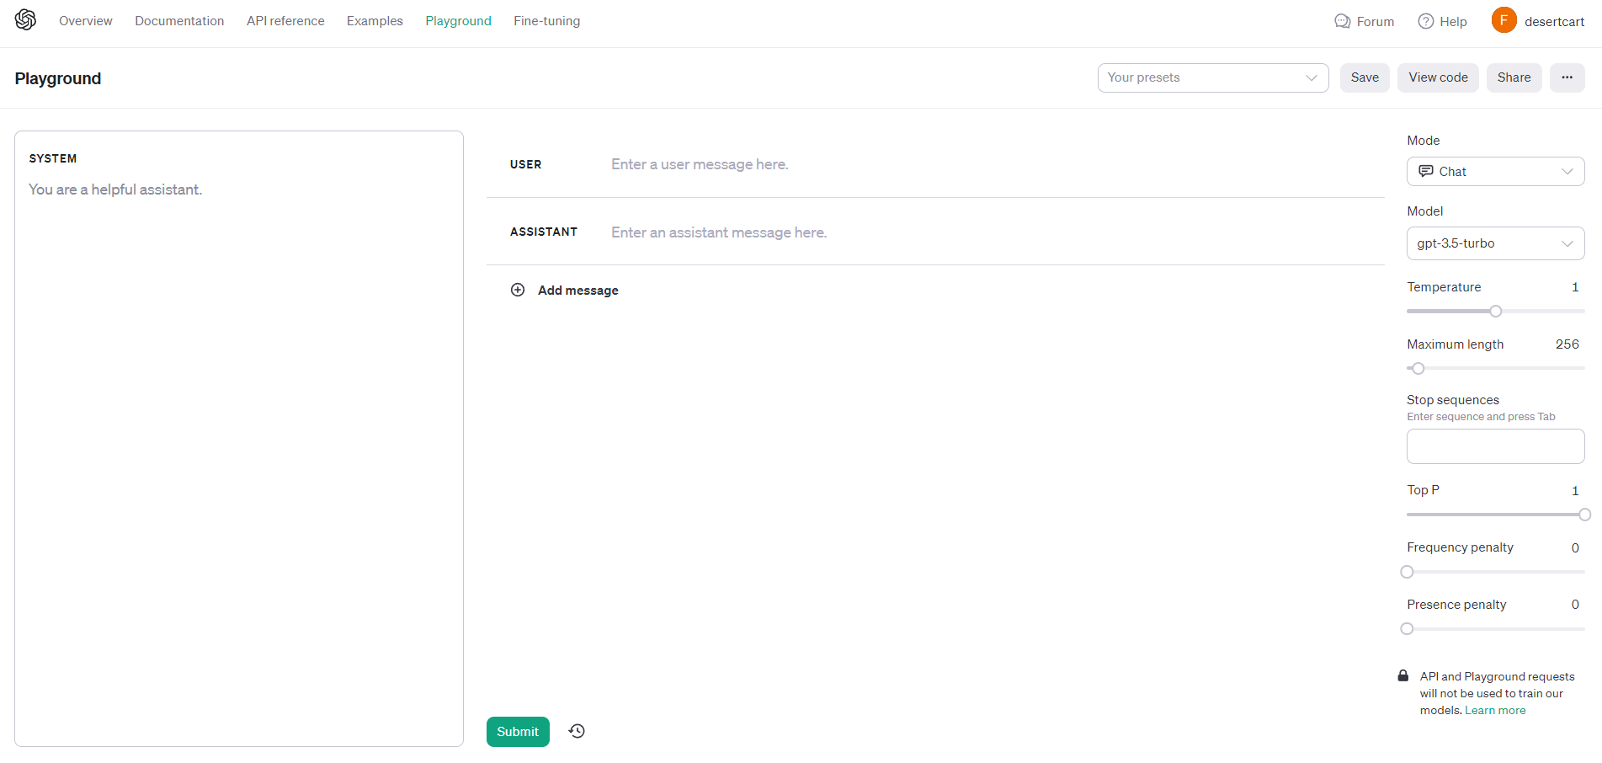
Choose model type
Choose model version
Determinism (0,2)
Edit user message
Max context length
Stop sequence
Edit AI message
Global instructions here
Top logit probability
Penalize repeat tokens
Penalize non unique tokens

Slide 8
Chat models
Chat models are “finetuned”. This means the foundational models are trained in a way similar to transfer learning to connivingly mimic conversations.
This doesn’t imply chat models are chat bots!
Chat models are still token predictors. However given their outputs are more conversational in tone, you can engineer together a chat bot. By stitching the conversation and completing on it over and over again.

Slide 9
Context windows
The context window is basically how large of a sequence the model can predict on.
The formula for the context window is as follows.
#Input tokens + # Output tokens + # System tokens
This means you can’t have an infinitely long chat with a LLM. At one point it’s going to get too long.
How do you engineer a solution for this?

Slide 10
Task 1
Create a chatbot that you can talk to in your terminal.

Slide 11
Steps to get working with gpt
Get OpenAI API Key.
Add API key to environment variables
Windows>> `setx OPENAI_API_KEY “<yourkey>”`
Mac/Linux >> echo “export OPENAI_API)JEY=‘yourkey’ >> ~/.zshrc
pip install openai
Profit
import os
import openai
openai.api_key = os.getenv("OPENAI_API_KEY") completion = openai.ChatCompletion.create( model="gpt-3.5-turbo",
messages=[ {"role": "system", "content": "You are a helpful assistant."}, {"role": "user", "content": "Hello!"} ] )
print(completion.choices[0].message)

Slide 12
Task 2
Do something about the limited context window of the chatbot.

Slide 13
THE END
Thanks for attending. Any questions ?

